Slide 1
Functional dependency

Slide 2
Functional dependency
Functional Dependencies
It is a constraint between the 2 sets of attributes from the database
It is a property of the semantic of the database
DB designers specify the semantics by functional dependencies
Functional dependency defines relationship among attributes of a relation schema.
Example:
FD: x -> y ; x, y are attributes
x determines y or y is dependent on x

Slide 3
Functional Dependency
Formal Definition: Attribute B is functionally dependant upon attribute A (or a collection of attributes) if a value of A determines a single value of attribute B at any one time.
Formal Notation: A → B This should be read as ‘A determines B’ or ‘B is functionally dependant on A’. A is called the determinant and B is called the object of the determinant.
Example:
Functional Dependencies
staffNo job dept dname
SL10 Salesman 10 Sales
SA51 Manager 20 Accounts
DS40 Clerk 20 Accounts
OS45 Clerk 30 Operations
staffNo → job
staffNo → dept
staffNo → dname
dept → dname

Slide 4
Formal definition
Definition : If R be a relation schema and X and Y are two subsets of R then we say that X functionally determines Y (X → Y) if for any pair of tuple t1 and t2 belonging to any state r(R) whenever t1[X] = t2[X], we must have t1[Y]=t2[Y] .
This means that the values of the Y component of a tuple in r depend on, or are determined by, the values of the X component; alternatively, the values of the X component of a tuple uniquely (or functionally) determine the values of the Y component.
We also say that there is a functional dependency from X to Y, or that Y is functionally dependent on X.

Slide 5
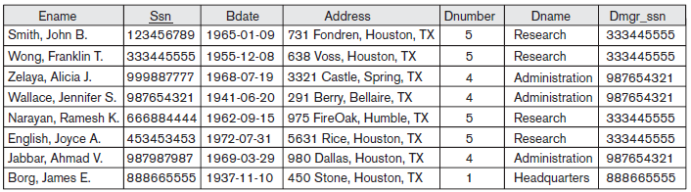

Slide 6
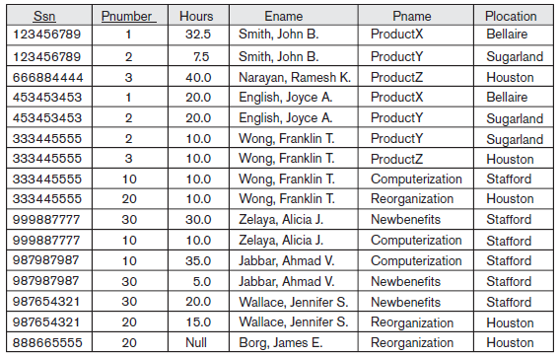

Slide 7
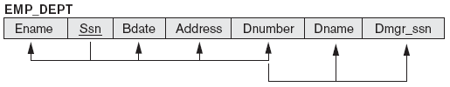
{Ssn} → {Ename, Bdate, Address, Dnumber}
{Dnumber} → {Dname, Dmgr_ssn}

Slide 8
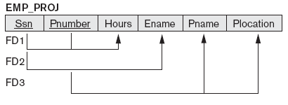
FD1: {Ssn, Pnumber} → {Hours}
FD2: {Ssn} → {Ename}
FD3: {Pnumber} → {Pname, Plocation}

Slide 9
Armstrong’s rules (axioms)
Assume that R is a relation schema and X, Y and Z
are subsets of R.
Reflexivity rule: If X is a super set of Y then X → Y.
Augmentation rule: If X → Y then XZ → YZ.
Transitivity rule: If X → Y & Y → Z then X → Z.

Slide 10
Additional rules
Union rule: If X → Y and X → Z then X → YZ
Decomposition rule: If X → YZ then X → Y and X → Z
Pseudo transitivity rule:
If X → Y and YZ → V then XZ → V
Composition rule: If X → Y and V → W then XV → YW

Slide 11
Closure of a set of attributes
Assume that X is a subset of a schema R & F is a set of functional dependencies that hold on R.
Closure of X is denoted by X⁺.
Closure of X (X⁺) is the maximal (biggest) super set of X such that X → X⁺.
Closure is a set of attributes that are functionally determines by the attribute set

Slide 12
Algorithm for computing X⁺
Given R & F find X⁺
Algorithm:
Begin
X⁺ := X
Repeat
For each functional dependency Y → Z ε F,
if X⁺ contains Y then
X⁺ := X⁺ U Z
Until X⁺ does not change.
End.

Slide 13
Example:
Let R={A,B,C,D,E}
F = { A -> B , A -> C; B -> D; C -> D; D -> E }
Find A⁺
Step-1: A⁺ = { A }
Step-2: A⁺ = { A , B , C}
Step-3: A⁺ = { A , B, C, D}
Step-4: A⁺ = { A , B, C, D}
Step-5: A⁺ = { A , B, C, D, E}
Similarly find B⁺, C⁺, D⁺

Slide 14
Example
R(A, B, C, G, H, I)
F = {A → B, A → C, CG → H, CG → I, B → H},
Find out (i) A⁺ & (ii) (AG)⁺

Slide 15
Closure
R(A, B, C, G, H, I)
F = {A → B, A → C, CG → H, CG → I, B → H},
A⁺ = A
Since A → B so A⁺ = AB
Since A → C so A⁺ = ABC
Consider CG → H, CG is not a subset of A⁺ so A⁺ remains
unaltered
Consider CG → I, CG is not a subset of A⁺ so A⁺ remains
unaltered
Consider B → H, B is a subset of A⁺ so A⁺ = ABCH

Slide 16
Closure
R(A, B, C, G, H, I)
F = {A → B, A → C, CG → H, CG → I, B → H},
(AG)⁺ = AG
= AGB ( because of A → B)
= AGBC (because of A → C)
= AGBCH (because of CG → H)
= AGBCHI (because of CG → I)
which remains unaltered despite B → H
(AG)⁺ = R

Slide 17
Super Key & Key
If the closure of the attributes/set of attributes determines all the attributes of the relation then it is the super key
Since (AG)⁺ = R hence AG is a super key of R
To find out whether it is a key, we have seen that A⁺ ≠ R & also note that G⁺ ≠ R
So AG is a key of R
If X is a subset of a relation schema R then X is a super key of R if X⁺ = R

Slide 18
Key
Input: A relation schema R and a set of functional
dependencies F on the attributes of R.
1. Set K := R;
2. For each attribute A in K
Begin
Compute (K – A)⁺ with respect to F;
If (K – A)⁺ contains all the attributes in R,
then set K := K – {A};
End.

Slide 19
Example
R(A, B, C, D, E) & F = {A → C, C → D, B → E}
Find out a key of R.
Answer: Key = AB

Slide 20
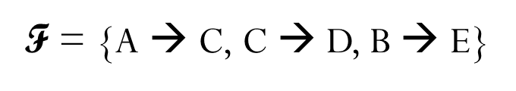
Key
Initialize K := ABCDE.
Suppose that we remove A from ABCDE and compute (BCDE)⁺.
We find that (BCDE)⁺ = (BCDE) ≠ R and hence A cannot be
removed from ABCDE.
Suppose that we remove B from ABCDE and compute (ACDE)⁺.
We find that (ACDE)⁺ = ACDE ≠ R and hence B too cannot be
removed from ABCDE.
Suppose that we remove C from ABCDE and compute (ABDE)⁺.
We find that (ABDE)⁺= ABDEC = R and hence C can be
removed from ABCDE. So K is now reduced to ABDE.

Slide 21
Key
Suppose that we remove D from ABDE and compute (ABE)⁺.
We find that (ABE)⁺ = ABECD = R and hence D can be
removed from ABDE. So K is reduced to ABE.
Suppose that we remove E from ABE and compute (AB)⁺.
We find that (AB)⁺ = ABCDE = R and hence E can be
removed from ABE.
So a key of the relation schema R is AB.

Slide 22
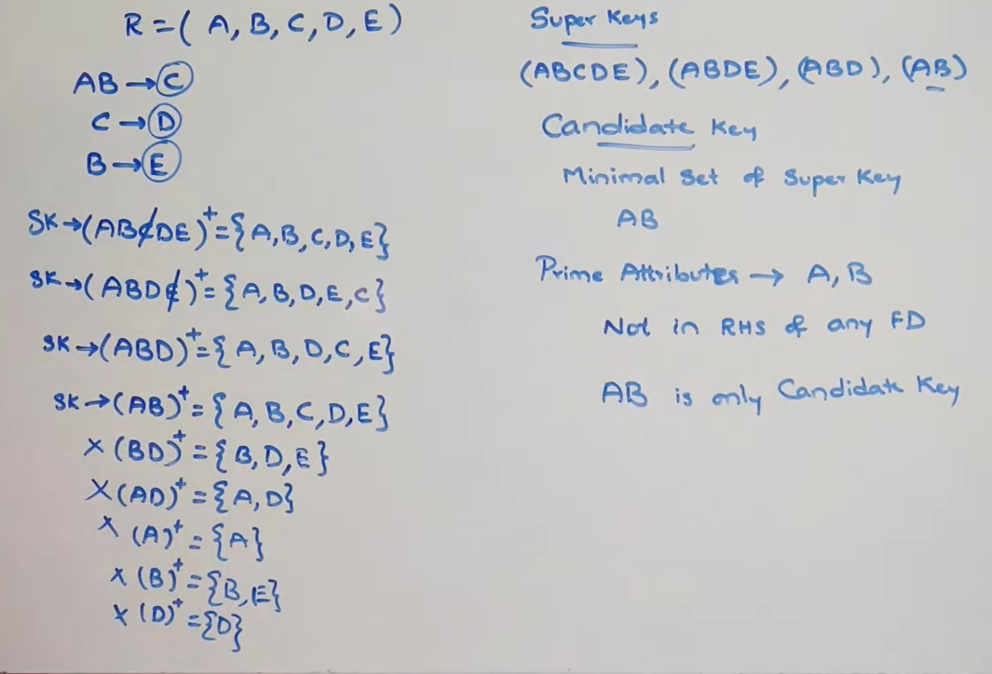
Find the Superkeys and Candidate Keys

Slide 23
Example
R(A, B, C, D, E, H) & F = {A → B, BC → D, E→ C, D→A }
Find out the candidate key of R.

Slide 24
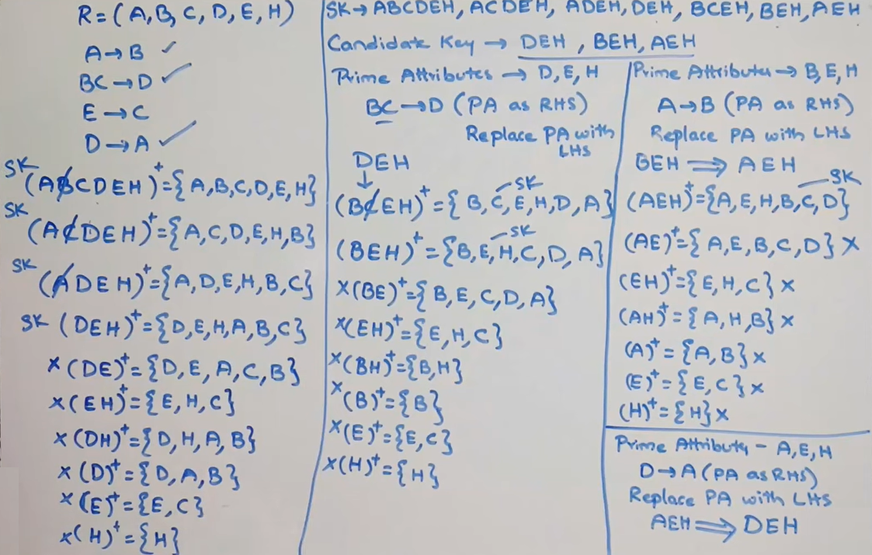
Notes:
If we know A we may find B

Slide 25
Example
R(A, B, C, D) & F = {A → B, B → C, C → BD}.
Find out candidate key(s) of R.

Slide 26
Key
ABCD⁺ = R
ACD⁺ = R
AD⁺ = R
A⁺ = ABCD = R and so A is a key.
B⁺ = BCD ≠ R and so B cannot be a key.
C⁺ = CBD ≠ R and so C cannot be a key.
The super keys are : ABCD, ACD, AD, A
The minimal super key is the candidate key, so R has one minimal super key and it is A

Slide 27
Example
R(A, B, C, D, E, G, H) &
F = {A → B, B → ACE, C → BGD, G → DH}.
Find out Candidate key(s) of R.
A⁺=AB
ABCE
ABCEGD
ABCEGDH=R

Slide 28
Key
A⁺ = ABCEGDH = R and so A is a key.
B⁺ = BACEGDH = R & so B is also a key.
C⁺ = CBGDHAE = R and so C also is a key.
G⁺ = GDH and so G is not a key.
So there are three keys of R and they are A, B and C.

Slide 29
Example
R(A, B, C, D, E) &
F = {A → B, B → A, B → C, D → A}.
Find out key(s) of R.

Slide 30
Key
A⁺= ABC ≠ R so A cannot be a key.
B⁺ = BAC ≠ R, so B cannot be a key.
D⁺ = DABC ≠ R and so D cannot be a key.
(DE)⁺ = DEABC = R and so DE is a key of R.

Slide 31
Inference
R & F
X → Y not a member of F
Is it possible to infer X → Y from F?
Find out X⁺ with respect to F
If X⁺ contains Y then X → Y can be inferred from F.

Slide 32
Example
F = {A → C, AC → D, E → AD, E → H}
A → CD – Can it be inferred from F?
A⁺ = ACD
A → CD can be inferred F
E → AH can be inferred F, because E⁺ = EADCH

Slide 33
Equivalence
R, F₁ & F₂
F₁ ≡ F₂
Two sets of functional dependency are said to be equivalent if every functional dependency of one set can be derived from the other set of functional dependency.

Slide 34
Example
R(A, B, C, D),
F₁ = {A → B, B → C, AC → D},
F₂ = {A → B, B → C, A → D}.
Are F₁ & F₂ equivalent?

Slide 35
Solution
We find that the functional dependency A → D of F₂ can be inferred from F₁ because
A⁺ with respect to F₁ is
A⁺ := A = AB = ABC = ABCD which contains D and hence A → D can be inferred from F₁.
Again AC → D of F₁ can be inferred from F₂ because
(AC)⁺ with respect to F₂ is
(AC)⁺ := AC = ABC = ABCD which contains D and hence AC → D of F₁ can be inferred from F₂.
Hence F₁ and F₂ are equivalent.

Slide 36
Example
R(A, B, C)
F₁ = {A → B, A → C} & F₂ = {A → B, B → C}
Are F₁ & F₂ equivalent?

Slide 37
Solution
The first functional dependency in the two sets are the same
Consider A → C of F₁
Compute A⁺ w.r.t. F₂
A⁺ = ABC
hence A → C can be derived from F₂

Slide 38
Solution….
Consider B → C of F₂
Compute B⁺ w.r.t. F₁
B⁺ = B which does not contain C
Hence B → C cannot be inferred from F₁
So F₁ and F₂ are not equivalent

